Slide 1
Angular & TypeScript
By. ahmedmohamedmvp@gmail.com

Slide 2
Installation

Slide 3
Creating Project
ng new projectName // it will cerate new folder with name projectName
which stylesheet format would you like to use ---- choose css
do you want to enable server-side rendering ---- choose NO

Slide 4
Run the project
ng serve --port 5000 // run the project at specific port [temporary solution]
Open package.json + "scripts" object + Change the "start" include the port
"start": "ng serve --port 5000"
Angular.json ➔ projects ➔ your-project-name ➔ architect ➔ serve ➔ options ➔ Add a "port" property inside the "options" block → "port": 5555

Slide 5
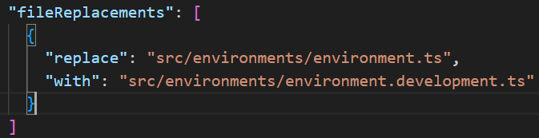
Environment Creation
Inside src folder
ng g environments
It creates two folder:
environment.ts // when you build this file will be considered
environment.development.ts // when you run this file will be considered
Update Angular.json

Slide 6
Start Routing

Slide 7
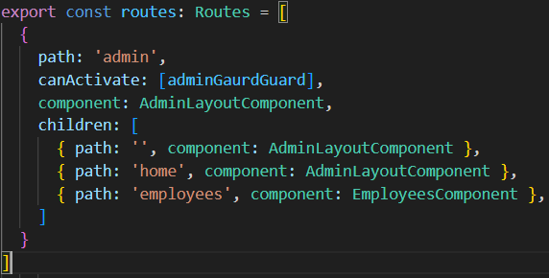
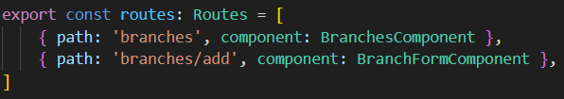
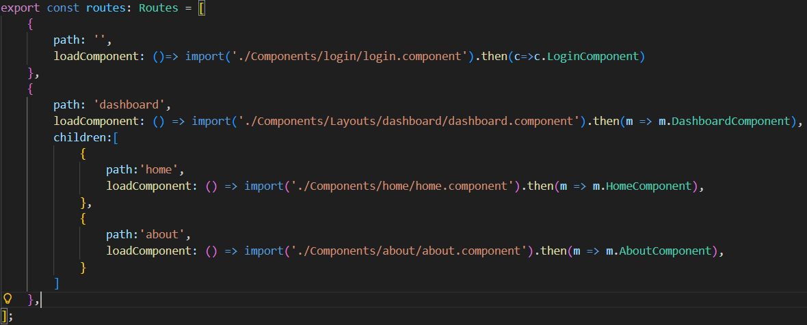
Routes [app.route.ts] , Lazy loading

Slide 8

Navigate Via HTML

Slide 9

Navigate Via TS

Slide 10


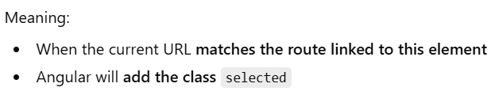
RouterLinkActive,

Slide 11
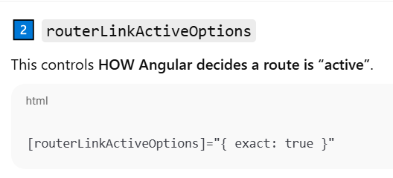
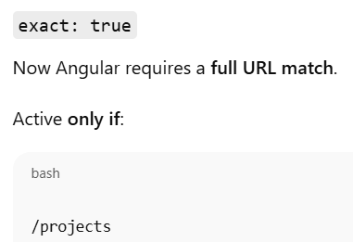
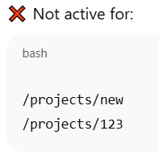
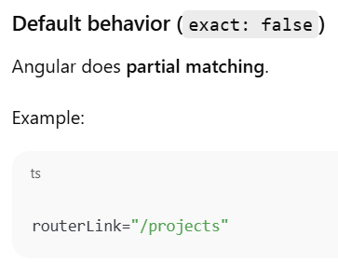
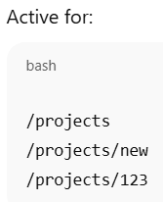
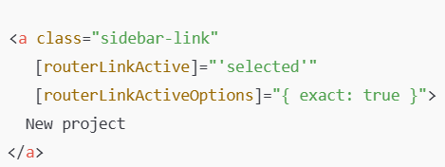
routerLinkActiveOptions

Slide 12

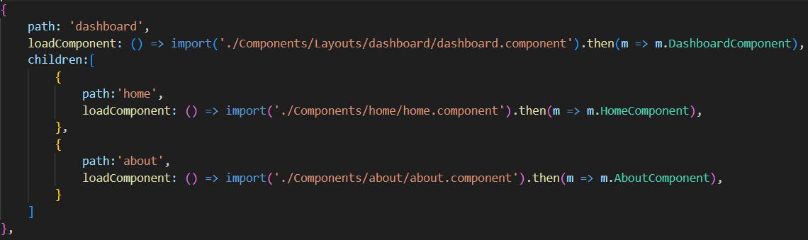
Router outlet
In this example we have sidebar(dashboard) component // existed at layouts/dashboard

Slide 13
END Routing

Slide 14
Start Angular Life cycle

Slide 15
1. constructor() [commonly used]
Triggers when
called when Angular initializes the component class
What should happen here
initialization and injection
Avoid trying to interact with the DOM or perform complex initializations here.
Avoid making API calls here.
The component isn’t fully created yet, so the view (DOM elements) isn’t available, and input properties are not yet initialized.

Slide 16
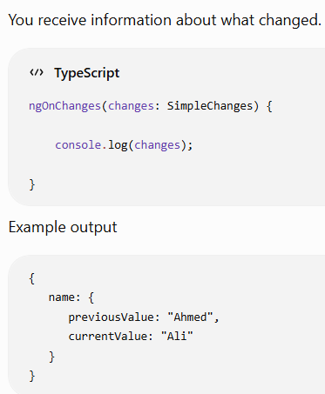
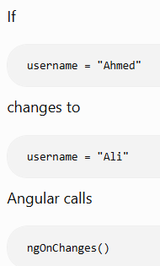
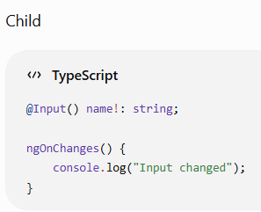
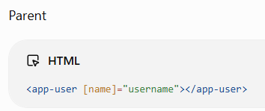
2. ngOnChanges() [commonly used]
Triggers when
whenever an @Input() value changes.
Runs every time the component's inputs properties have been changed.
It is triggered at least once before ngOnInit in case of you have properties with Input decorator
ngOnChanges will only run when input properties change, so it's not triggered if there are no input properties in the component.
What should happen here
You receive information about what changed.
ngOnChanges(changes: SimpleChanges) { console.log(changes); }

Slide 17
3. ngOnInit() [commonly used]
Triggers when
Runs once after Angular has initialized the component.
What should happen here
API calls, Loading data

Slide 18
4. ngDoCheck()
Triggers when
Runs every time Angular checks the component.
This happens a lot: Button clicked, Even moving the mouse can trigger many checks depending on your app.
What should happen here
API calls, Loading data

Slide 19
5. ngAfterContentInit()
Triggers when
If component is a child and inserted into parent
So inside child ngAfterContentInit() is called
runs once.
What should happen here

Slide 20
6. ngAfterContentChecked()

Slide 21
7 ngAfterViewInit() [commonly used]
Triggers when
Runs after Angular creates the component's HTML.
What should happen here
Use this hook to perform actions that require access to the component’s rendered view or the DOM

Slide 22
8. ngAfterViewChecked()

Slide 23
9. ngOnDestroy()
Triggers when
Runs before Angular removes the component.
What should happen here
Perfect place for cleanup.

Slide 24
End Angular Life cycles

Slide 25
Start Binding

Slide 26
Binding
Interpolation
attribute (property) binding
class binding
style binding
Event Binding

Slide 27
Event binding
Function in event binding should be invoked
(submit)="SubmitAddingColorOption" // XXX
(submit)="SubmitAddingColorOption()"

Slide 28
End Binding

Slide 29
Start Access element

Slide 30
access element
To access the element in Agular you need to assign to it Template Reference Variable
For example
<div #myElement>Some content</div>
The #myElement is called a Template Reference Variable.
Pointer to that specific DOM element
The # is to declare the variable
ElementRef<any> , any is determined as needed, could be HTMLSelectElement, HTMLInputElement
To access the element in HTML
<input type="number" #inputCount>
<button (click)="calc(inputCount.value)">calc</button>

Slide 31
access element [ViewChild]
To access the element in ts
@ViewChild('TemplateReferenceVariable') selectElement!: ElementRef<HTMLSelectElement>;
@ViewChild('selectElement', { static: true }) secondElement!: ElementRef<HTMLSelectElement>;
Without { static: false }
It the default, you do not need to write it
The element will be available only in ngAfterViewInit()
Use this if the element is inside a structural directive like *ngIf or *ngFor.
It will be undefined if it is used inside ngOnInit
With { static: true }
The element will be available in ngOnInit ()
Use this if the element is always present in the DOM

Slide 32
End Access element

Slide 33
Start Observable

Slide 34
Observable
it is used to handle (manage) asynchronous operations
Emits multiple values over time (better for data streaming) (data producer)
Lazy (executed when subscribed).
Can be canceled (by unsubscribing).
Included in ReactiveX Library
A stream of data or events (like news) that can be sent over time.

Slide 35
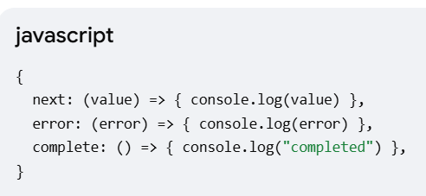
Observer
It is an object (or a set of callbacks) that defines how to handle the data coming from the Observable
The object passed inside the .subscribe() method is the Observer
The complete is called when the Observable finishes its lifecycle , NOT called if an error happens

Slide 36
Subscriber
acts as the middleman: It takes value from the Observable and hands it to the Observer's next() method
The subscriber parameter inside the new Observable constructor is Subscriber.

Slide 37
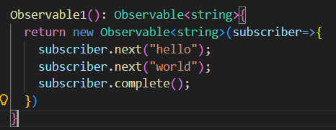
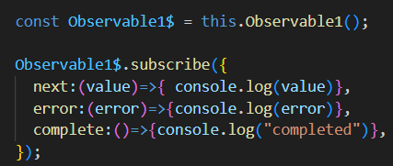
Observable example

Slide 38
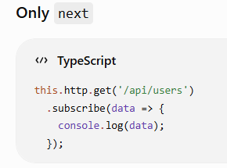
Next()
The next could only be in the observer

Slide 39
Complete()
is called after the Observable has finished emitting all its values and only if no error occurred.

Slide 40
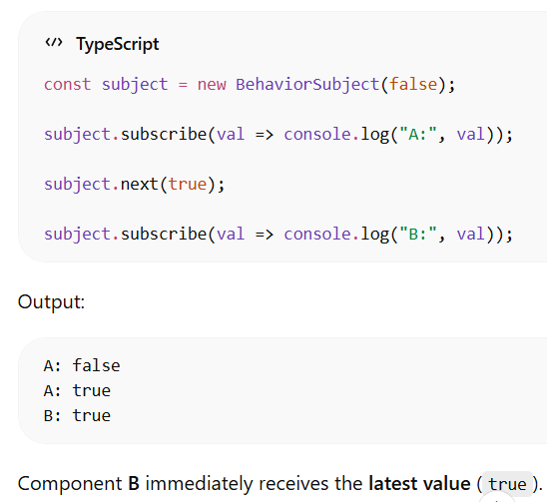
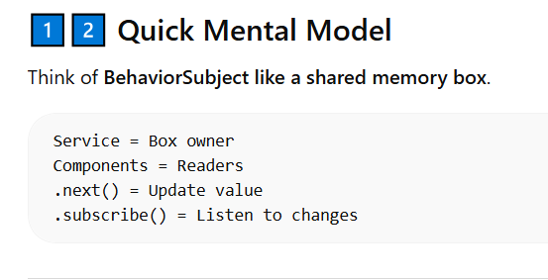
BehaviorSubject
manage shared state between components, like login status, theme changes, cart updates, etc.
A BehaviorSubject is a special type of Observable that
stores the latest value
Immediately sends the last value to new subscribers
So any component that subscribes will always receive the current state instantly.
BehaviorSubject = Observable + Current Value Storage
When a Subject emits a value using .next(), all current subscribers receive that value.
The subscriber is like listener to value

Slide 41
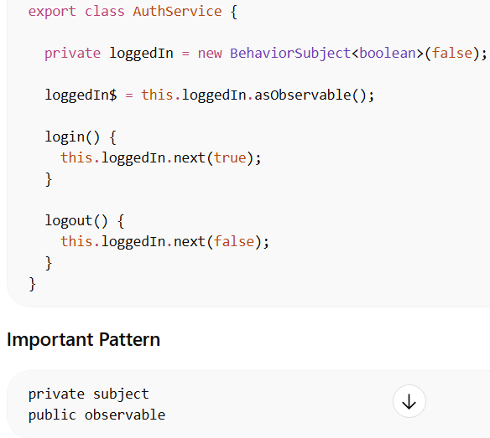
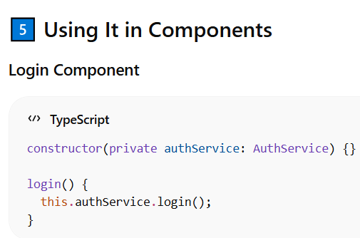
Example 1: Login State
The Observable here relays (forwards) whatever the BehaviorSubject emits.

Slide 42
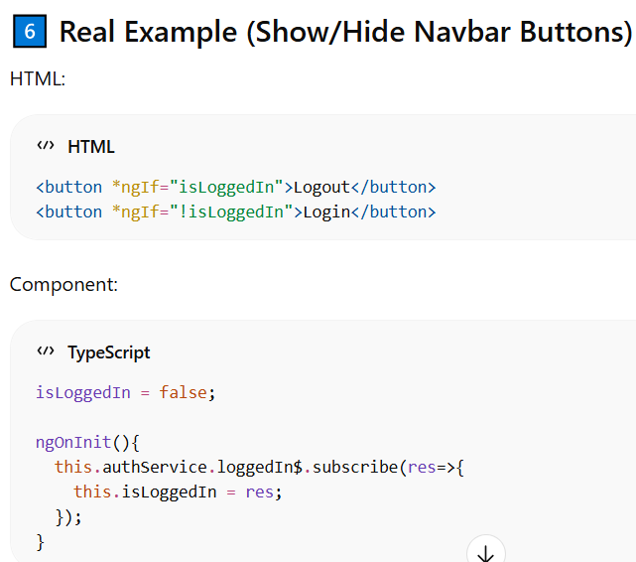
Example 1: Login State [cont.1]

Slide 43
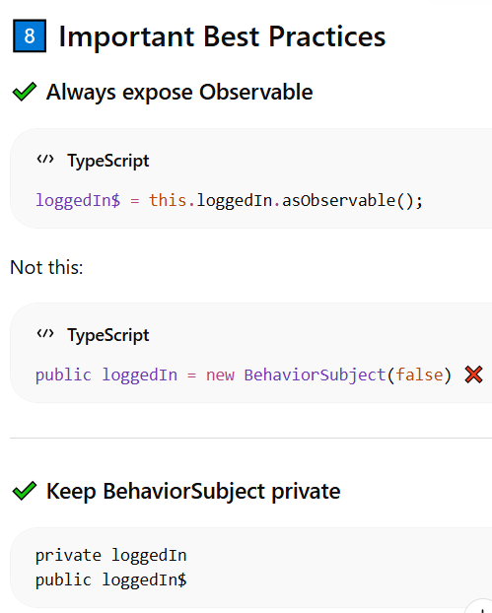
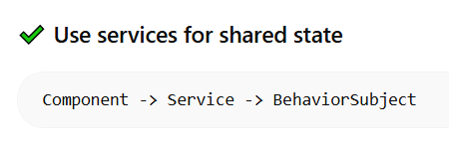
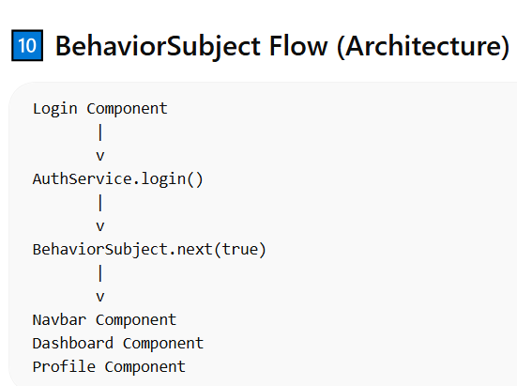
BehaviorSubject [cont.]

Slide 44
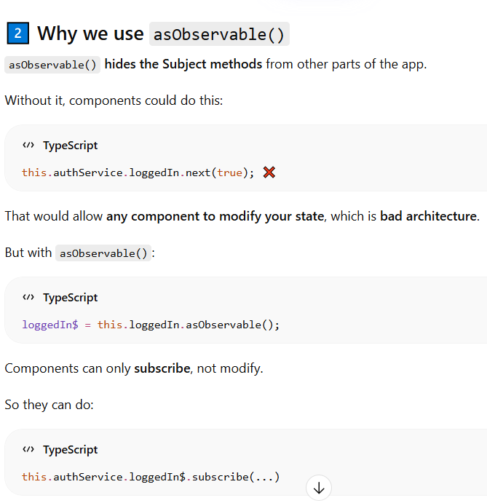
BehaviorSubject [cont.2]

Slide 45
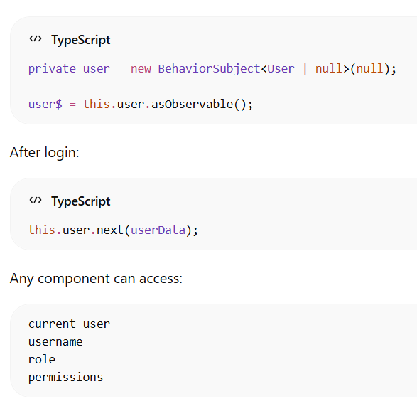
Advanced Example (User Object)

Slide 46
Plain Subject

Slide 47
PIPES with Observable
It allows you to transform, filter, or manipulate the data emitted by an observable before it reaches its final subscribing
Returns a New Observable: When you use the pipe method, it doesn't modify the original observable. Instead, it returns a new observable that applies the defined transformations.
const obs = new Observable((subscriber) => {
subscriber.next(1); subscriber.next(2);
subscriber.next(3); subscriber.next(4); subscriber.next(5);
subscriber.complete(); // Signals that no more values will be emitted
}).pipe(
filter((data) => data > 2), // Filters out values less than or equal to 2
map((val) => val * 2) // Transforms remaining values by multiplying by 2
);

Slide 48
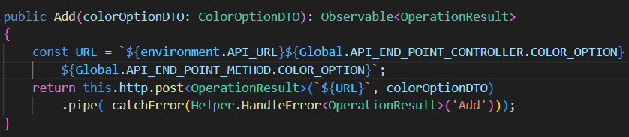
PIPES with Observable [cont.1]
Pipes could handle errors before the subscriber receives it.
pipe() allows you to attach operators to the Observable
catchError(Helper.HandleError<OperationResult>('Add’))
This means if request fails : network error, server error (500), bad request (400)
catchError intercepts the error then calls Helper.HandleError()

Slide 49
Pipeable Operators
inside pipe() you place operators, and they are commonly called RxJS operators (or pipeable operators).
map()
filter()
catchError()

Slide 50
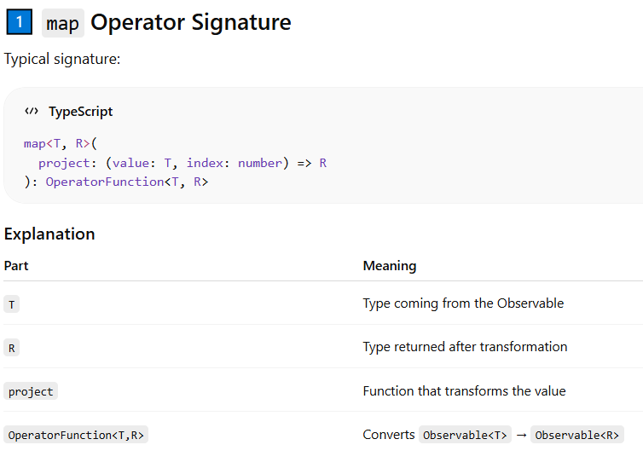
Pipeable Operators map
S

Slide 51
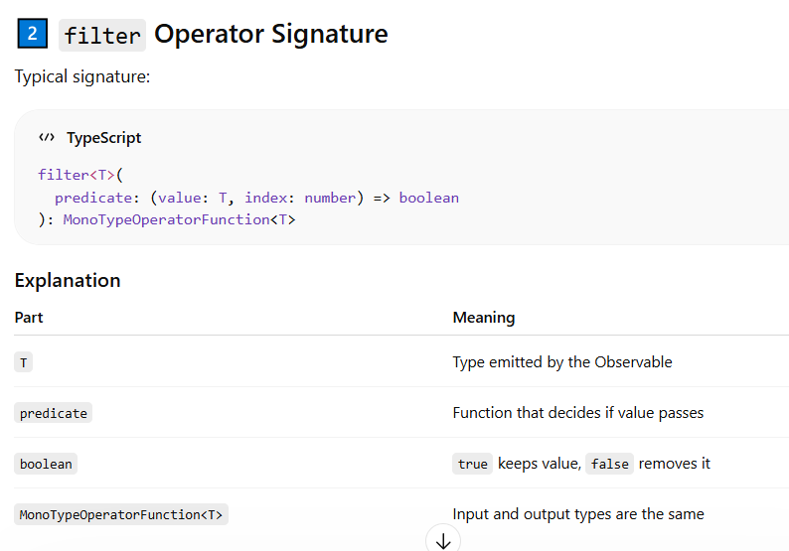
Pipeable Operators filter
S

Slide 52
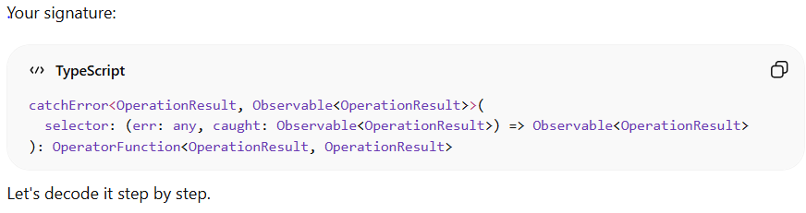
Pipeable Operators CatchError signature
catchError<OperationResult, Observable<OperationResult>>
OperationResult : Type emitted before error
Observable<OperationResult> : Type emitted before error
OperatorFunction<OperationResult, OperationResult>
receives an Observable emitting OperationResult
returns another Observable emitting OperationResult

Slide 53
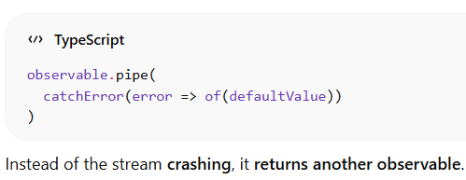
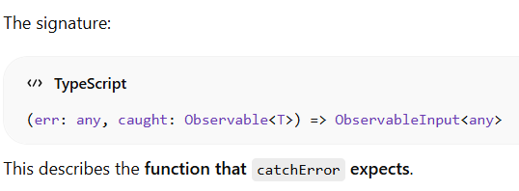

Pipeable Operators CatchError
catchError is an RxJS operator used inside pipe() to intercept errors from an Observable and replace them with another Observable.
error: This is the error thrown by the observable.

Slide 54
Finalize()
is an operator that lets you run code when an Observable finishes, regardless of how it finishes.
It runs at these scenarios:
The Observable completes successfully.
The Observable throws an error.
The subscription is manually unsubscribed.
It’s mechanism like Think of finalize() like the finally block in a standard JavaScript try/catch/finally

Slide 55
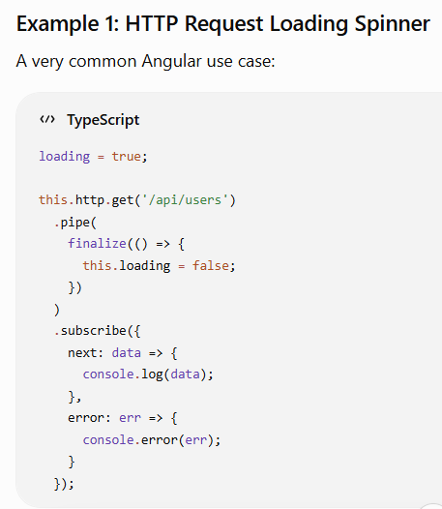
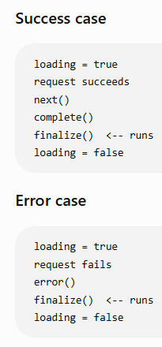
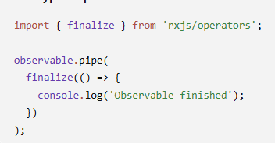
Finalize() [cont.1]

Slide 56
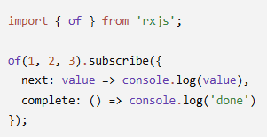
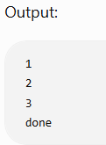
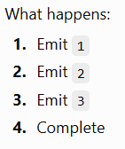
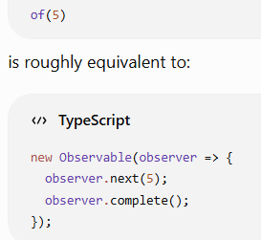
Of()
creates an Observable from the values you provide.
of(5) →
Why use it in Angular? Often for testing or when you already have data and need an Observable:

Slide 57
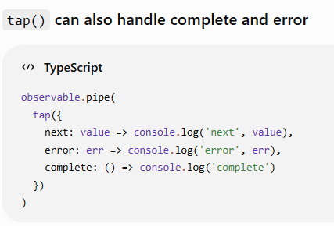
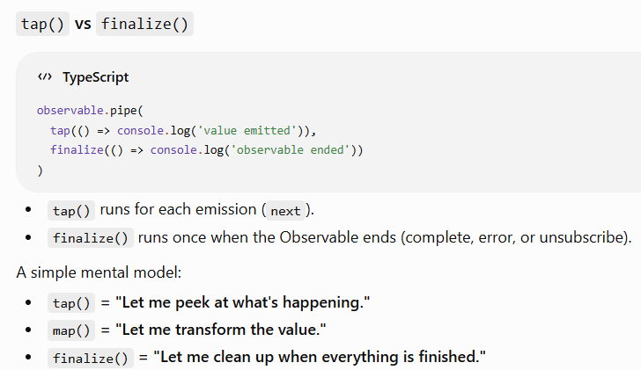
tap()

Slide 58
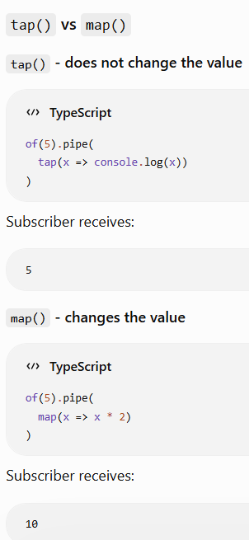
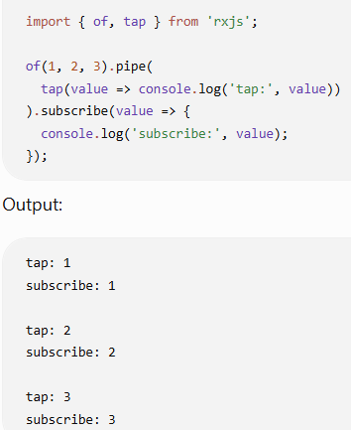
tap()
look at values emitted by observable without changing it, map() could change the values
Notice that tap() sees the values but does not modify them.

Slide 59
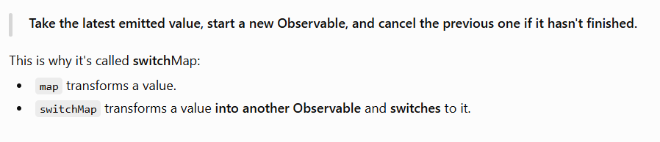
SwitchMap

Slide 60
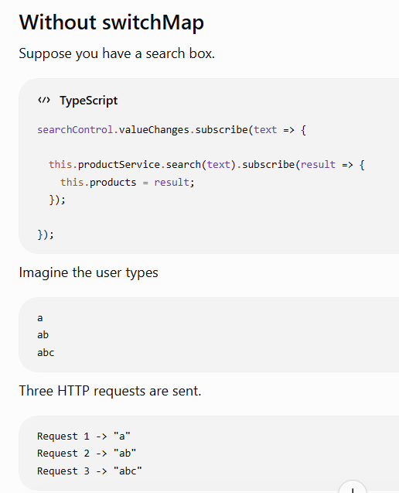
SwitchMap [cont.1]

Slide 61
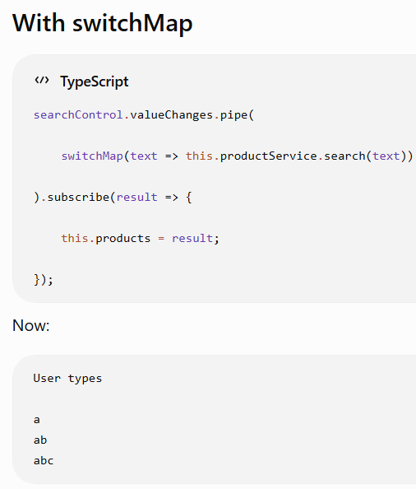

SwitchMap

Slide 62


SwitchMap

Slide 63



SwitchMap

Slide 64


SwitchMap [ multiple switchMap ]

Slide 65
End Observable

Slide 66
visible$ | async
<div class="loading" *ngIf="visible$ | async"></div>
visible$ is observable -- you component.ts has: visible$: Observable<boolean>;
The async pipe
subscribes to the observable
gets the latest emitted value
updates the UI when the value changes
unsubscribes when the component is destroyed
Without async, you'd need:
isVisible = false;
ngOnInit() { this.spinnerService.visible$.subscribe(value => { this.isVisible = value; }); }
<div *ngIf="isVisible"></div>

Slide 67
Creating side bar
ng g c SideBar --skip-tests

Slide 68

Creating new component
ng g c componentName --skip-tests
ng g c project-details --skip-tests
project-details folder will be created and includes
ProjectDetails.component.ts
ProjectDetails.Component.html
ProjectDetails.Component.css

Slide 69
Start Bootstrap

Slide 70
Adding bootstrap & Bootstrap icon
ng add @ng-bootstrap/ng-bootstrap //recommended, to use the component that need the JS code
npm i @ng-bootstrap/ng-bootstrap // like the above
at angular.json / at architect object / build object / options object
at styles array -- "node_modules/bootstrap/dist/css/bootstrap.min.css", // bootstrap CSS file
at scripts array -- "node_modules/bootstrap/dist/js/bootstrap.bundle.min.js" // bootstrap JS file
For angular 17 , ng-bootstrap 16 → Stable
npm i @ng-bootstrap/ng-bootstrap
npm i bootstrap-icons
at style array "node_modules/bootstrap-icons/font/bootstrap-icons.min.css"
Versions
npm install @ng-bootstrap/ng-bootstrap@15 // with angular 16
npm install @ng-bootstrap/ng-bootstrap@16 // with angular 17
npm install @ng-bootstrap/ng-bootstrap@17 // with angular 18

Slide 71
End Bootstrap

Slide 72
End Bootstrap

Slide 73
Start CSS

Slide 74
Addin CSS file globally
at src folder / css folder / css-extensions.css
at angular.json / at architect object / build object / options object
at styles array --- "src/css/css-extension.css"
Adding styles via angular.json is generally faster and more reliable for your application's initial load and overall stability compared to using an external CDN link in index.html
Why angular.json is usually faster
Reduced HTTP Requests: When you add files to angular.json, the Angular CLI bundles them into a single (or few) minified CSS files. The browser makes one request for your styles instead of multiple separate requests to different servers.

Slide 75
End CSS

Slide 76
Start SideBar with Layout 1

Slide 77
The behavior of following code will be
A side bar that appears at md+ screens
At screen less than md+ the side bar will disappeared and toggle (hamburger) button will appear to toggle the sidebar
The sidebar will be as offcanvas

Slide 78
Side bar HTML
<main class="container-fluid d-flex p-0 h-100">
<!-- ONE sidebar: works as offcanvas on from xs to sm, normal from md -->
<div class="offcanvas offcanvas-start d-md-block border-0" tabindex="-1" id="a-sidebar">
<div class="offcanvas-header d-md-none">
<h5 class="offcanvas-title">Hebrak</h5>
<button class="btn-close" data-bs-dismiss="offcanvas"></button>
</div>
<div class="offcanvas-body p-0">
<ul class="nav flex-column p-2">
<li class="nav-item"><a routerLink="/mainLayout/Product" class="nav-link fw-bold ">Product</a></li>
<li class="nav-item"><a [routerLink]="['/mainLayout','about']" class="nav-link fw-bold">About</a></li>
<li class="nav-item"><a href="#" class="nav-link fw-bold">Logout</a></li>
</ul>
</div>
</div>
</main>

Slide 79
Sidebar CSS
#a-sidebar.offcanvas {
max-width: 250px !important;
background-color: #343a40;
}
@media (min-width: 768px) {
#a-sidebar.offcanvas
{
/* the default is transform: translateX(-100%); */
transform: none !important;
/* default visibility: hidden*/
visibility: visible !important;
/*default position: fixed*/
position: static !important;
width: 200px;
min-height: 100vh;
height: 100% !important;
}
}

Slide 80
Sidebar ts
import { Component } from '@angular/core';
import { RouterLink } from '@angular/router';
@Component({
selector: 'app-side-bar',
imports: [RouterLink],
templateUrl: './side-bar.component.html',
styleUrl: './side-bar.component.css',
})
export class SideBarComponent {
}

Slide 81
Main layout.ts
@Component({
selector: 'app-main-layout',
imports: [RouterOutlet,SideBarComponent],
templateUrl: './main-layout.component.html',
styleUrl: './main-layout.component.css'
})
export class MainLayoutComponent implements OnInit {
currentLanguage = 'ar';
constructor(private languageService: LanguageService){}
ngOnInit(): void {
this.currentLanguage = this.languageService.getCurrentLanguage();
}
toggleLanguage(): void {
this.currentLanguage = this.languageService.getCurrentLanguage();
this.languageService.toggle();
this.currentLanguage = this.currentLanguage === 'ar' ? 'en' : 'ar';
}
}

Slide 82
Main-layout.html
<main class="container-fluid d-flex p-0 mw-100">
<app-side-bar></app-side-bar>
<div class="col flex-column page-content">
<div class="layout-header d-flex align-items-center text-bg-dark p-10" style="font-family: cursive;">
<button class="btn btn-primary me-10 fs-4 me-2" type="button" data-bs-toggle="offcanvas" data-bs-target="#a-sidebar">☰</button>
<div class="d-flex justify-content-between w-100">
<p class="p-0 m-0 fw-bold fs-4">Hebrak</p>
<button class="btn btn-outline-light" (click)="toggleLanguage()"> {{ currentLanguage === 'ar' ? 'English' : 'العربية '}} </button>
</div>
</div>
<div class="fluid-container p-10">
<router-outlet></router-outlet>
</div>
</div>
</main>

Slide 83

main layout (app.routes.ts)

Slide 84
End Sidebar with layout 1

Slide 85
@Injectable
@Injectable ({
providedIn: 'root'
})
register a service in Angular’s Dependency Injection system so it can be automatically created and injected anywhere in the application.
Angular knows this class can be injected into components or other services.
Create one single instance of the service for the whole application. [ Singleton Service ]

Slide 86
Start Forms

Slide 87

Template Driven Forms
Import FormsModule inside the component

Slide 88
ReactiveFormsModule (model driven forms)
FormControl Prop
this.ColorOptionForm.value // {ColorName: '', ColorHexCode: ''}
this.productForm.controls.ColorName.Value // value is a read-only
this.productForm.controls.price.hasError('required')
ColorOptionForm = new FormGroup({
ColorName: new FormControl(''),
ColorHexCode: new FormControl(''),
})
ColorOptionForm = new FormGroup({
ColorName: new FormControl(''),
ColorHexCode: new FormControl(''),
})

Slide 89
ReactiveFormsModule (FormControl) [cont.1]
FormControl Properties
value: string
valueChanges.subscribe ( val=>console.log(val) ) // Observable that emits whenever value changes
statusChanges.subscribe (val=>console.log(val) ) // Observable that emits when validation status changes
errors // { {key: value}, {key: value} }
valid // boolean
touched // The form control has been blurred (focused and then left).
pristine // The value has not changed from the initial value
dirty // The value has changed from the initial value
status // Valid, Invalid, Pending, Disabled
valid // bool
invalid // bool
hasError('required') // bool

Slide 90
ReactiveFormsModule (FormControl) [cont.2]
FormControl Properties
disable : Disables the control
disabled : bool , A control is disabled when its status is DISABLED, Disabled controls are exempt from validation checks
enable :
enabled :
parent : Reference to parent ( FormGroup or FormArray )
setValue('Ahmed’) // automatically triggers validation
patchValue('Ahmed');
reset()
markAsTouched();
markAsUntouched();
markAsDirty();
markAsPristine();

Slide 91
ReactiveFormsModule ( FormGroup ) [cont.3]
FormGroup Properties
value : { username: 'Ahmed' , password: '123456' }
getRawValue(): Includes disabled controls
controls['ColorHexCode'] //
get('ColorHexCode') //
valid: bool, A control is valid when its status is VALID
invalid
errors // Errors applied to the group itself (not children)
status
form.setValue({ username: 'Ahmed’, password: '123’ }); // Must include ALL controls
form.patchValue({ username: 'Ahmed’ }); // lets you update only the fields you provide, always triggers validation
form.markAllAsTouched(); // The form control has been blurred (focused and then left).
form.markAsDirty(); // The value has changed from the initial value.
form.markAsPristine(); // The value has not changed from the initial value.
form.markAsUntouched();

Slide 92
ReactiveFormsModule ( FormGroup ) [cont.4]
FormGroup Properties
updateValueAndValidity()

Slide 93
ReactiveFormsModule creation
The FormControl(‘initial value’, ValidatorFn | ValidatorFn[] | null , AsyncValidatorFn | AsyncValidatorFn[] | null)
updateOnBlur
ALL validations run after user blur from input
ColorOptionForm = new FormGroup({
ColorName: new FormControl('', {
validators: [ Validators.required ],
asyncValidators: [this.UniqueNameValidator()],
updateOn: 'blur'
},
),
ColorHexCode: new FormControl('', [Validators.required]),
})

Slide 94
End Forms

Slide 95
Sweat Alert
npm install sweetalert2
Swal.fire(options) // it returns promise --- Promise<SweetAlertResult<any>>
SweetAlertResult.isConfirmed
SweetAlertResult.isDenied
SweetAlertResult.isDismissed

Slide 96
Start Sweat Alert

Slide 97
End Sweat Alert

Slide 98
HTTP Client
You need to make httpClient Injectable [make provider for httpClient]
configure angular httpClient Service to be available for injection
At app.config.ts : at provider array add ---- provideHttpClient(withFetch())

Slide 99
Start Validation

Slide 100
Is Name Unique validation
IsNameUniqueValidator(): AsyncValidatorFn {
return (control: AbstractControl): Observable<ValidationErrors | null> => {
if (!control.value)
return of(null);
if ( this.IsEditMode && this.SelectedCategory && control.value === this.SelectedCategory.name) {
return of(null);
}
return this.categoryService.IsNameUnique(control.value, this.SelectedCategory?.id)
.pipe(
map(result => (result.data ? null : { nameIsNotUnique: true })),
catchError(() => of(null))
);
};
}

Slide 101
End Validation

Slide 102
New Types
HTMLInputElement
let target = e.target as HTMLInputElement
KeyboardEvent
If(event.key=== "Enter") {}
TemplateRef<T>
This is the official Angular type for any <ng-template> reference
ElementRef<T>
is a class that gives you direct access to a DOM element inside your component
usually used together with @ViewChild.
Ex: @ViewChild('ColorHexCodeInput') colorHexCodeInput!: ElementRef<HTMLInputElement>;
NgbModalRef
Modal
NgbActiveModal
NgbModal

Slide 103
AsyncValidatorFn & ValidatorFn & ValidationErrors
AsyncValidatorFn signature
interface AsyncValidatorFn {
( control: AbstractControl ): Promise< ValidationErrors | null > | Observable< ValidationErrors | null >;
}
AsyncValidatorFn DT means it waits a function that takes AbstractControl as a parameter and returns observable or promise
ValidationErrors = { [ key: string ]: any; }; // object with any number of poperties
interface ValidatorFn {
( control: AbstractControl ): ValidationErrors | null;
}

Slide 104

Type
purpose
If you want to make a variable that waits a specific function
implentation
type MyMethod = ( num1: number, num2: number ) => number;

Slide 105
EventEmitter
page = new EventEmitter<number>(); // "I can emit numbers.“ , [ at child]
(page)="handlePage($event)“ // at parent
Angular internally does something LIKE: page.subscribe(value => { handlePage(value);});
This mean listen to page until something is emitted, run handlePage() when value is emitted
page.emit(5);
emit() calls ALL SUBSCRIBED FUNCTIONS.
The Flow
page.emit(5);
(page)="handlePage($event)“ == : page.subscribe(value => { handlePage(value);});
handlePage(5);
The child emit , the parent listen

Slide 106
HttpRequest
This creates a custom Angular HTTP request object
Creates a manual HTTP request instead of using shortcuts like:
this.http.get() , this.http.post()
It gives you more control over: Headers, upload progress, download progress, body, header, response type, events
new HttpRequest(method, url, body?, options? )
It is immutable DT
Options: it is an object its members as following
headers: HttpHeaders
Params: HttpParams

Slide 107
HttpHeaders
headers: HttpHeaders
const headers = new HttpHeaders({ Authorization: 'Bearer token’, 'Content-Type' : 'application/json' });
Add Header: headers.append('token', '123’);
Set Header: headers.set('token', '123’);
Delete Header: headers.delete('token');
Get Header : headers.get('Authorization');
HttpHeaders objects are immutable. That means methods like .set(), .append(), and .delete() do not modify the existing instance — they return a new HttpHeaders object instead.
Usage
let headers = new HttpHeaders(); headers = headers.set('Authorization', 'Bearer token');
const headers = new HttpHeaders() .set('Authorization', 'Bearer token’) .set('Content-Type', 'application/json’);
const clonedReq = req.clone({ headers: req.headers.set('x-token', token)});

Slide 108
HttpParams
is the class used to build and manage URL query
HttpParams is immutable.
params: new HttpParams() .set('page', '1’) .set('limit', '10’);
Set replace value
Final URL: /api/users?page=1&limit=10
new HttpParams()
.append('category', 'books') .append('category', 'movies’)
Append: add another value, Useful for Multi-Select, Array
params.getAll('category’); // ['books', 'movies']
Final URL: /api/user?category=books&category=movies

Slide 109
HttpParams [ CONT.]
Add many params at once using appendAll
const params = new HttpParams().appendAll ( { page: 1, limit: 10, sort: 'name' } );
Initialize from object.
const params = new HttpParams({ fromObject: { page: '1’, limit: '10’, search: 'john’ } });
Reading
params.get('page’); // 1
params.getAll('category’); // ['books', 'movies’]
params.keys(); // Returns all parameter names.
Checks existence.
params.has('page’);
delete()
params = params.delete('page');
params = params.delete('category', 'books’);
Converting to String
params.toString(); // page=1&limit=10

Slide 110
HttpErrorResponse
class for representing failed HTTP requests made through HttpClient
Whenever an HTTP request fails, Angular does not return a normal HttpResponse<T>. Instead, it emits an HttpErrorResponse
Example with subscribe→ error: (error: )

Slide 111
HttpErrorResponse
class for representing failed HTTP requests made through HttpClient
Whenever an HTTP request fails, Angular does not return a normal HttpResponse<T>. Instead, it emits an HttpErrorResponse
Example with subscribe→ error: (error: HttpErrorResponse)=>{}
HttpErrorResponse properties
status: HttpStatusCode (enum)
statusText
url
error: Contains the actual error returned by the backend.
ok: boolean

Slide 112
ng-container
ng-container
group elements and apply structural directives ( like *ngIf, *ngFor, *ngSwitchCase )
DOM Impact: It is a logical grouping that is not rendered as a separate element in the browser's DOM
Use Case : avoid unnecessary wrapping elements that might affect styling.

Slide 113


ng-template
ng-template
Defines a reusable block of HTML content that is not rendered by default
DOM Impact: The content within an ng-template is not rendered in the DOM unless explicitly demand it
ng-template: It is a ready code waits you to call it
*ngTemplateOutlet: it tell angular bring the template that its name myTemplate and render it here

Slide 114

ng-template
x

Slide 115

ng-template [cont.2]
let-itemmm="item“ // it means receive a value that it is name called item from context and this value will be available within ng-template with name item

Slide 116
End Angular DT

Slide 117
Start new variable

Slide 118
New Variables
$event:
a special Angular template variable that represents the emitted event object.
$ is a mendatory
#inputCount:
template variable
we call it without #

Slide 119
End new variable

Slide 120
Start File& Download & Upload

Slide 121


window.URL.createObjectURL(File)
creates a temporary browser URL that points to a file/blob stored in browser memory.
It's very commonly used for previewing before uploading.
You can use this generated link as the src for images, videos, audio, or download links so the browser can display or download the file
blob:http://localhost:4200/8a7f2c91-....
only creates a temporary URL for the browser.
When you're finished with the preview: URL.revokeObjectURL(item.previewUrl); // to release resources

Slide 122
Download code
At Service
httpClient.post(URL, payload, { response: blob });
At ts code
request = this.service.download(payload).subscribe({
next: (response: Blob)=>{
const downloadURL = window.URL.createObjectURL(response);
const link = document.createElement('a’); link.href = downloadURL;
link.download = 'SanctionAML_Report.xlsx’;
document.body.appendChild(link); link.click();
document.body.removeChild(link);
window.URL.revokeObjectURL(downloadURL);
Swal.close(); // close the current opening sweat alert
}
});
To cancel the operation (download) : request.unsubscribe();

Slide 123
Uploading
At service
const formData = new FormData();
formData.append("Image", productDTO.Image as File);
At edit
if(categoryDTO.Image instanceof File) { formData.append("image", categoryDTO.Image as File) }
categoryDTO.Image // Image: File | null

Slide 124
End Download & Upload

Slide 125

Modal
import { NgbModal, NgbModalRef } from '@ng-bootstrap/ng-bootstrap’;
let-modal --- Receives a value from context and makes its name is modal inside ng-template and the question is from where this value is gained
When modal is opened VIA : this.modalService.open(editModal);

Slide 126


Modal [cont.]
import { NgbModal, NgbModal, NgbModalRef } from '@ng-bootstrap/ng-bootstrap';
Constructor ( private modalService: NgbModal ) {}

Slide 127
Start Angular Material

Slide 128
Installation
ng add @angular/material
Choose a prebuilt theme name, or "custom" for a custom theme: Azure/Blue
At angular.json
At style : "@angular/material/prebuilt-themes/azure-blue.css"

Slide 129
mat-paginator
imports: [MatPaginatorModule],
(page)
MatPaginator.page: EventEmitter<PageEvent>
It wait a method that has PageEvent as parameter
Event emitted when the paginator changes the page size or page index.
What PageEvent contains
pageIndex: number;
previousPageIndex?: number;
pageSize: number;
length: number;
<mat-paginator
[pageSizeOptions]="[4,8,10,15]"
[length]="PaginationResult?.totalCount"
[pageSize]="PaginationResult?.pageSize"
[pageIndex]="PaginationResult?.currentPage! -1"
[showFirstLastButtons]="true"
(page)="onPageChange($event)">
</mat-paginator>
onPageChange(pageEvent: PageEvent) {
this.PageParam.PageNumber = pageEvent.pageIndex+1;
this.PageParam.PageSize = pageEvent.pageSize;
this.GetPagedList();
}

Slide 130
<mat-divider>
create a horizontal or vertical line styled with a Material theme
<mat-divider></mat-divider> // horizontal
<mat-divider [vertical]="true"></mat-divider>

Slide 131
mat-autocomplete

Slide 132
End Angular Material

Slide 133
Febric.js

Slide 134



Layout [cont.]
Create sidebar component at components folder

Slide 135
Start Localization

Slide 136
localization
Installation and configuration
npm install @ngx-translate/core @ngx-translate/http-loader
At app.config.ts , provider
provideTranslateHttpLoader({ prefix: './assets/Localization/', suffix: '.json' }),
provideTranslateService({
fallbackLang: 'ar’,
loader: { provide: TranslateLoader , useClass: TranslateHttpLoader }
})

Slide 137



LanguageService

Slide 138
At App.Component
you must ensure LanguageService is instantiated during app startup
constructor(private LanguageService: LanguageService){}
Why : to call its constructor to get the last chosen lang

Slide 139


Usage At component
To change the lang in all app and vice versw

Slide 140
if you intend to use key from en.json or ar.json at component
.html
you need to import TranslatePipe
imports: [TranslatePipe],
At html <label class="ms-2">{{"nameAr" | translate}}</label>
ts
At ts : this.translate.use(lang);

Slide 141
End Localization

Slide 142
Start interceptors

Slide 143

Creating interceptor
For example we are going to implement interceptor that handle HttpErrorResponse

Slide 144
Register the interceptor
{ provide: HTTP_INTERCEPTORS, useClass: HttpErrorInterceptor, multi: true },
provide: HTTP_INTERCEPTORS
It means I register this to participate in HTTP interceptor pipeline
Angular later looks for everything registered under HTTP_INTERCEPTORS and builds the interceptor chain
useClass: HttpErrorInterceptor
The class itself
multi: true
Withtout multi: true, angular would expect only one value for HTTP_INTERCEPTOR and every new registration will overwrite the previous one
{ provide: HTTP_INTERCEPTORS, useClass: HttpErrorInterceptor}, { provide: HTTP_INTERCEPTORS, useClass: AuthInterceptor},
INTERCEPTORS = AuthInterceptor // cause it is the last one
With multi: true, HTTP_INTERCEPTORS = [AuthInterceptor, HttpErrorInterceptor ]

Slide 145
Configuring HttpClient
provideHttpClient(withFetch(), withInterceptorsFromDi() )
withInterceptorsFromDi()
look in DI container for anything registered under HTTP_INTERCEPTORS and use those interceptors to build interceptors chain
HttpClient → All registered interceptors → Fetch Backend

Slide 146
Start Pipes

Slide 147
pipes
applied on value while directive applied on elements
used to display (transform) value in a desired format
async : subscribe to an Observable or Promise and display its latest value.
uppercase
lowercase
titlecase: [ pascal case ]
date
{{ today | date }} // Jun 12, 2026
{{ today | date:'dd/MM/yyyy’ }} // 12/06/2026
json

Slide 148
End Pipes

Slide 149
End interceptors

Slide 150
Type Script

Slide 151



Optional chaining [ ?.]
It is only allowed when reading values not writing
this.PageParam?.PageNumber = 55; // XXX cause it can not be used when assigning values
The three correct usages

Slide 152
!
called the definite assignment assertion operator
It tells the compiler "I promise this variable will be assigned a value later, so stop showing an uninitialized error
When Strict Mode is enabled in TypeScript, you must initialize every variable or property you declare.

Slide 153
index signature
let myDynamicObject: { [key: string]: any } = {};
Declares that 'myDynamicObject' can have any string key, with any value type
// Valid assignments (TypeScript will not complain):
myDynamicObject["name"] = "Alice"; // string value
myDynamicObject.age = 42; // number value (dot notation works too)
myDynamicObject["isActive"] = true; // boolean value
myDynamicObject.nested = { prop: "hello" }; // object value

Slide 154
as keyword
te
interface A { x: number; } const obj = { x: 10, y: 20 }; const test: A = obj;
Valid : because --- ✔ x exists , ✔ y is ignored
interface User { name: string; } const obj = { age: 10, }; const user = obj as User;
TypeScript will accept it, even though: name is missing
At runtime -- user.name // undefined

Slide 155



type narrowing
“Does the object obj have a property called success?”
It narrows the type of obj inside the if to OperationResult

Slide 156
Find()
find(...) returns a reference to the object inside the items array (not a copy).
let x = (this.PaginationResult?.items.find(x => x.id == this.SelectedColorOptionId))!;
x is pointing to the same object in memory as the one inside items
Any changes made on x is reflected to the

Slide 157


Enum
note : Enums in TypeScript are technically objects where :
Keys are strings.
Values are numbers (if it's a numeric Enum) or strings (if it's a string Enum).

Slide 158

Method that takes a methods as parameters

